Slide 1
Computer Networks
CS 430

Slide 2
Network Layer

Slide 3
Objectives
Forwarding and Routing
Internet Protocol
IPv4
IPv6
ICMP
Routing algorithms
link state
distance vector
hierarchical routing
BGP

Slide 4

















Network Layer
application
transport
network
data link
physical
Host-to-host
Sender encapsulates segments into packets
Receiver extracts segments to transport layer
Network layer protocols in every host, router
Router examines header fields in all IP datagrams passing through it
network
data link
physical
network
data link
physical
network
data link
physical
network
data link
physical
network
data link
physical
network
data link
physical
network
data link
physical
network
data link
physical
network
data link
physical
application
transport
network
data link
physical
network
data link
physical
network
data link
physical

Slide 5
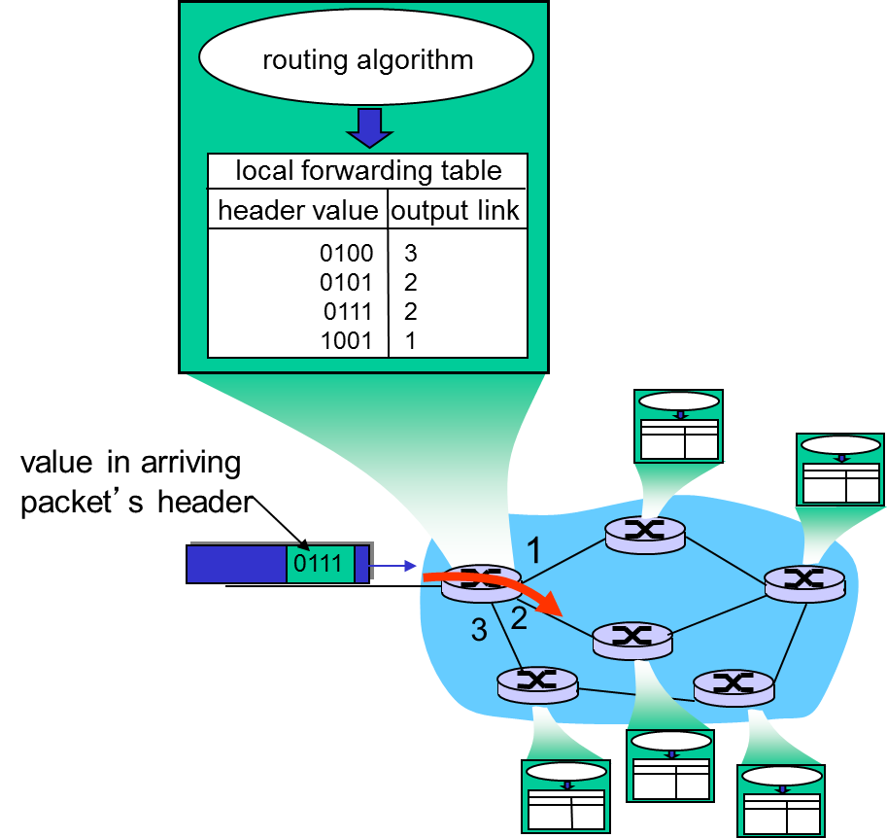
Network Layer Functions
Forwarding
Move packets within a router
Routing
Determine a route taken by packets from source to destination
Routing algorithms

Slide 6
Network Layer Planes
Data Plane
Control Plane
Local, per-router function
Determines how datagram arriving on router input port is forwarded to router output port
Forwarding function
Network-wide logic
Determines how datagram is routed among routers along end-end path from source host to destination host
Two control-plane approaches
traditional routing algorithms: implemented in routers
software-defined networking (SDN): implemented in (remote) servers

Slide 7
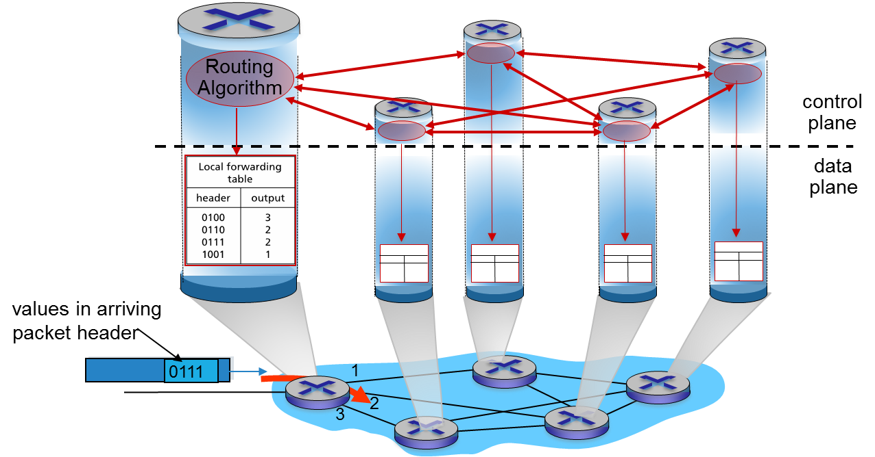
Per-router Control Plane

Slide 8
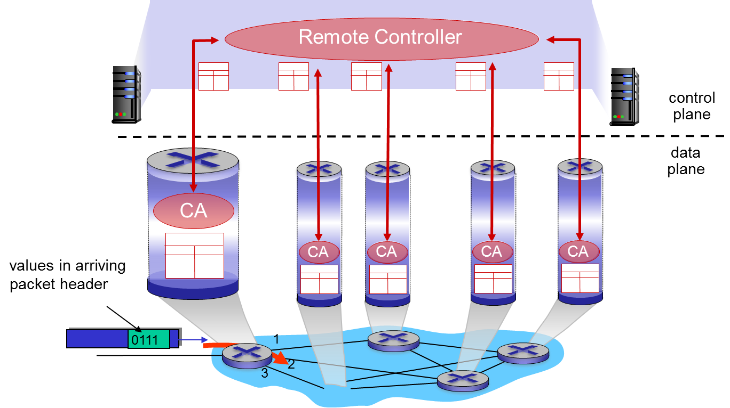
Logically Centralized Control Plane

Slide 9
Connection Setup
What network layer protocol(s) do you know?
IP, IPv6
There are others too!
ATM, frame relay, X.25
Virtual connection established
Like TCP
Hosts and routers are involved
Circuit switching vs packet switching
Host-to-host
Mutually exclusive
Network core
Internet
Best effort
No guarantees
No congestion control

Slide 10
Network Service Model
Individual packets
Guaranteed delivery
Guaranteed delay
Packet flow
In-order delivery
Guaranteed minimum bandwidth
Max jitter
Security

Slide 11

Packet (Datagram) Networks
No call setup at network layer
Routers: no state about end-to-end connections
no network-level concept of “connection”
Packets forwarded using destination host address
application
transport
network
data link
physical
application
transport
network
data link
physical
1. send datagrams
2. receive datagrams

Slide 12
Routers

Slide 13
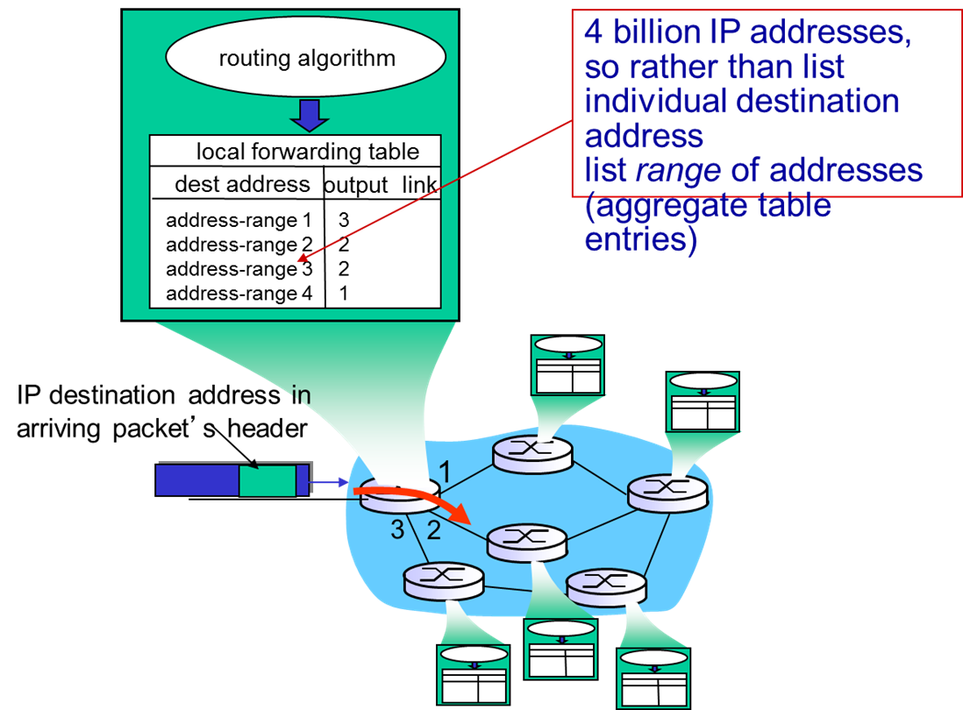
Packet Forwarding

Slide 14
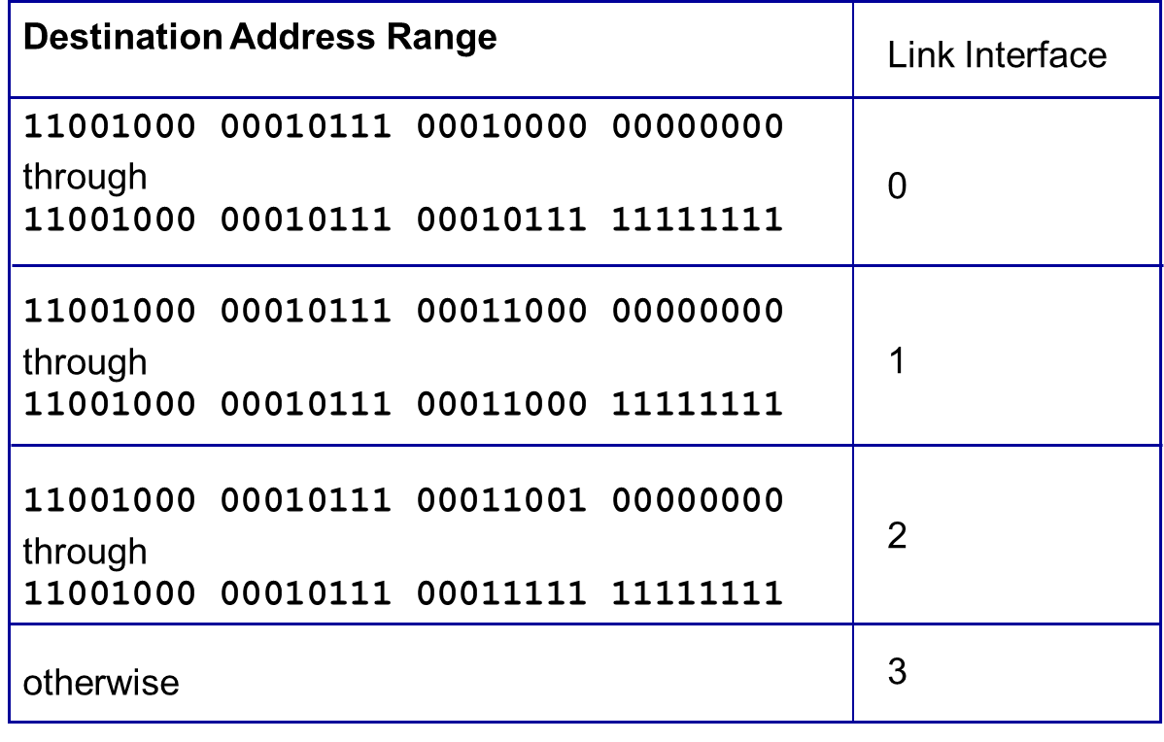
Packet Forwarding Table

Slide 15
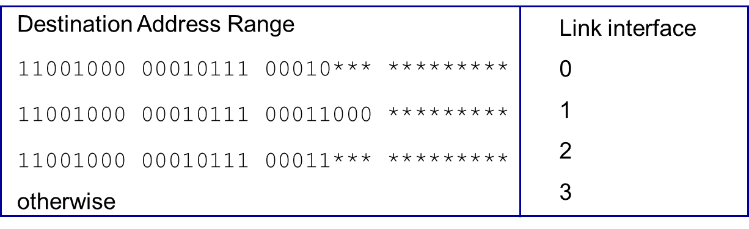
Longest Prefix Matching
Destination 1
11001000 00010111 00010110 10100001
Destination 2
11001000 00010111 00011000 10101010

Slide 16
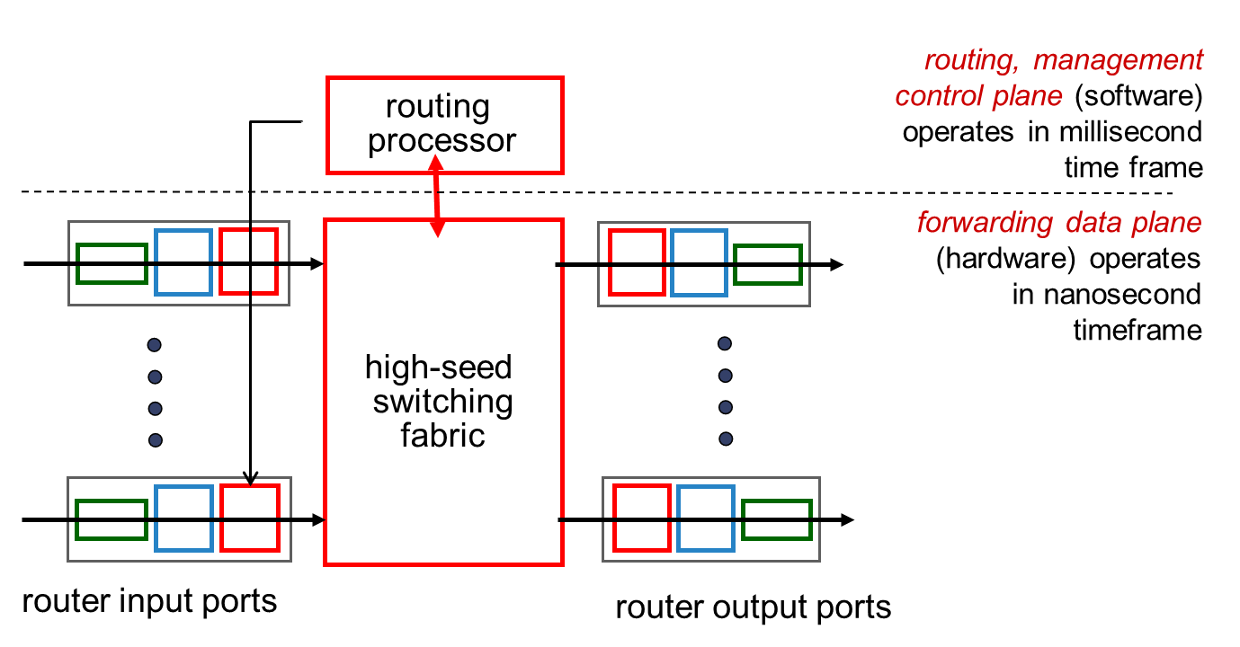
Router Architecture Overview

Slide 17
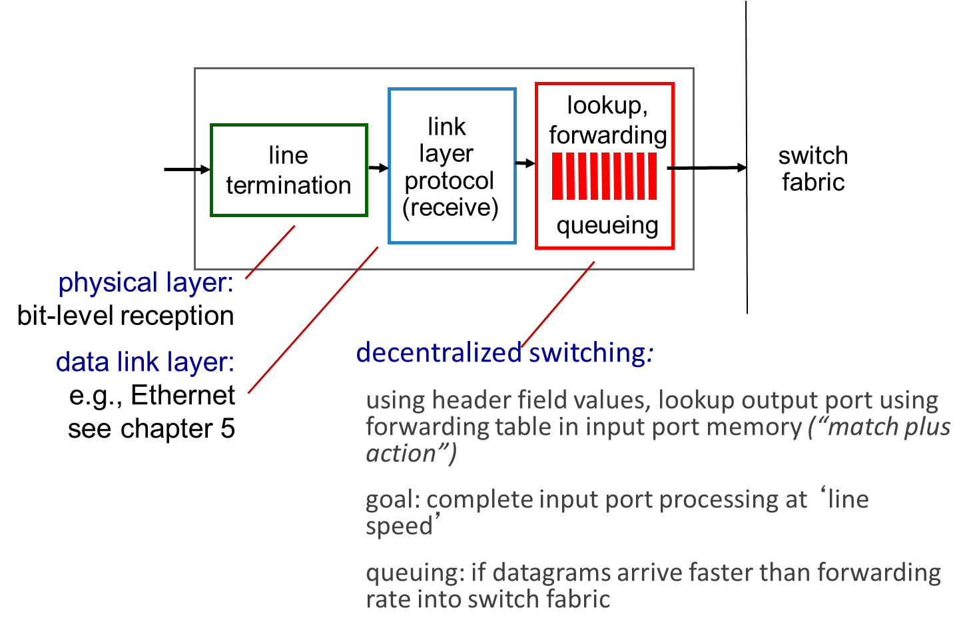
Input Port Functions

Slide 18
Switching Fabrics
transfer packet from input buffer to appropriate output buffer
switching rate: rate at which packets can be transfer from inputs to outputs
often measured as multiple of input/output line rate
N inputs: switching rate N times line rate desirable
three types of switching fabrics
memory
memory
bus
crossbar

Slide 19
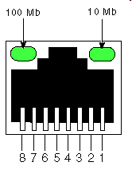
Switching via Memory
First generation routers
traditional computers with switching under direct control of CPU
packet copied to system’s memory
speed limited by memory bandwidth
input
port
(e.g.,
Ethernet)
output
port
(e.g.,
Ethernet)
memory
system bus

Slide 20
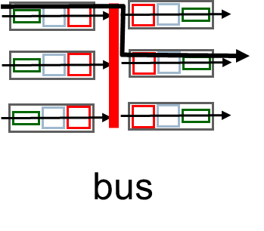
Switching via a Bus
Shared bus
Bus contention
switching speed limited by bus bandwidth
32 Gbps bus, Cisco 5600: sufficient speed for access and enterprise routers

Slide 21
Switching via Interconnection Network
Overcome bus bandwidth limitations
banyan networks, crossbar, other interconnection nets initially developed to connect processors in multiprocessor
Advanced design
fragmenting datagram into fixed length cells, switch cells through the fabric.
Cisco 12000: switches 60 Gbps through the interconnection network
crossbar

Slide 22
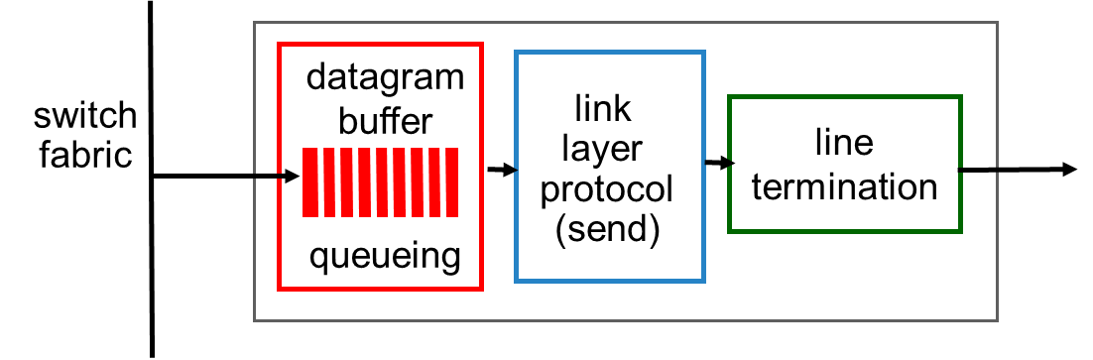
Output Ports
buffering required when datagrams arrive from fabric faster than the transmission rate
scheduling discipline chooses among queued datagrams for transmission

Slide 23
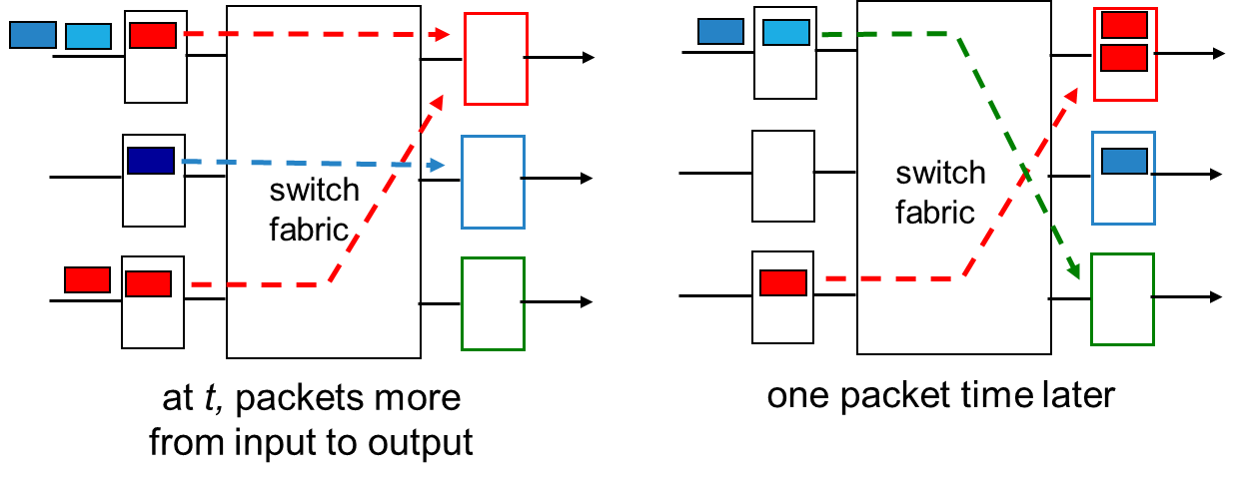
Output Port Queuing
buffering when arrival rate via switch exceeds output line speed
queueing (delay) and loss due to output port buffer overflow!

Slide 24
How Much Buffering?
RFC 3439 rule of thumb: average buffering equal to “typical” RTT (say 250 msec) times link capacity C
e.g., C = 10 Gpbs link: 2.5 Gbit buffer
recent recommendation: with N flows, buffering equal to
.
RTT C
N

Slide 25
Input Port Queuing
fabric slower than input ports combined -> queueing may occur at input queues
queueing delay and loss due to input buffer overflow!
Head-of-the-Line (HOL) blocking: queued datagram at front of queue prevents others in queue from moving forward
switch
fabric
switch
fabric
output port contention:
only one red datagram can be transferred. lower red packet is blocked
one packet time later: green packet experiences HOL blocking

Slide 26
Internet Protocol

Slide 27
The Internet (Network) Layer
transport layer: TCP, UDP
routing protocols
path selection
RIP, OSPF, BGP
IP protocol
addressing conventions
datagram format
packet handling conventions
network
layer
forwarding
table
ICMP protocol
error reporting
router “signaling”
link layer
physical layer

Slide 28
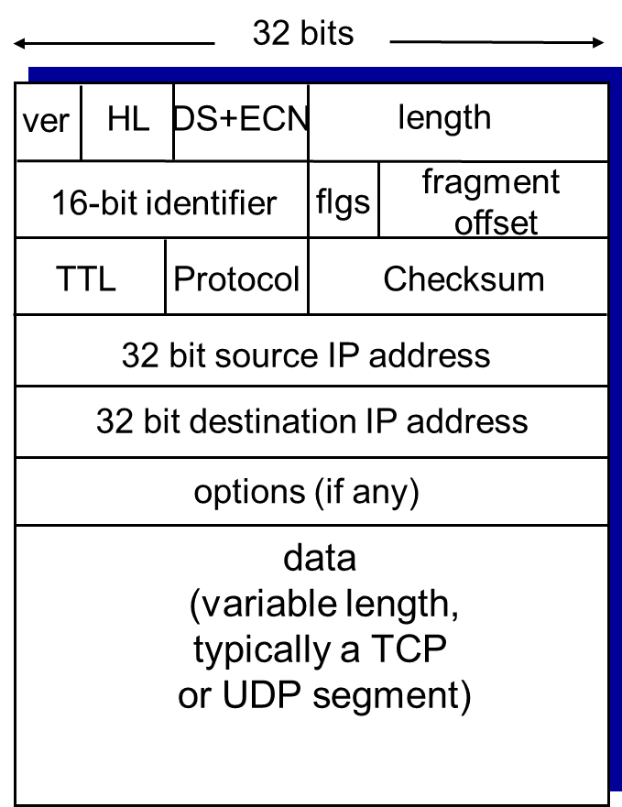
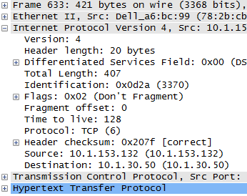
IPv4 Header
Notes:
HL = 5 (length in 2-byte words)
Len – total packet size (in bytes)
Flags – fragmentation info (3 bits)
Offset – fragmentation info

Slide 29
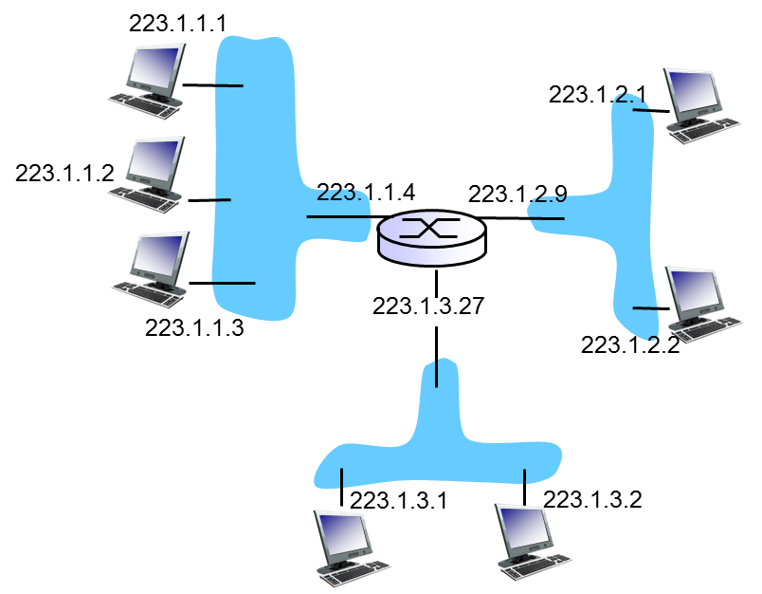
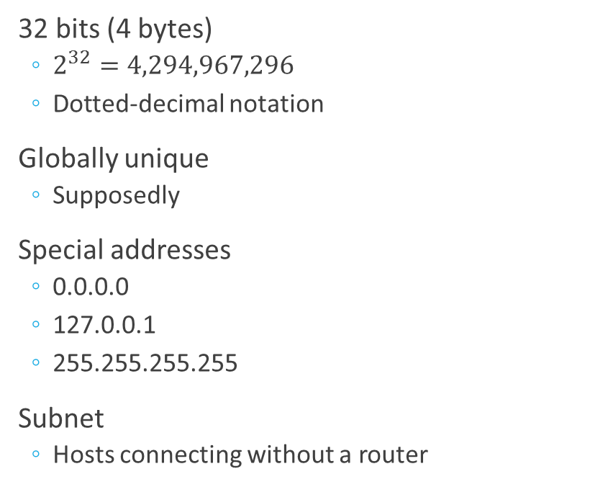
IPv4 Addressing
32 bits (4 bytes)
$2^{32}=4,294,967,296$
Dotted-decimal notation
Globally unique
Supposedly
Special addresses
0.0.0.0
127.0.0.1
255.255.255.255
Subnet
Hosts connecting without a router

Slide 30
IPv4 Addressing
Subnetting
Network address
Host address
Mask
Classful vs Classless
CIDR
Special addresses
All 0s in the host part
All 1s in the host part
127.0.0.1/8

Slide 31
Subnets
223.1.1.2
223.1.1.1
223.1.1.4
How many?
What’s wrong with addresses in the diagram?
223.1.1.3
223.1.9.2
223.1.7.0
223.1.9.1
223.1.7.1
223.1.8.1
223.1.8.0
223.1.2.6
223.1.3.27
223.1.2.1
223.1.2.2
223.1.3.1
223.1.3.2

Slide 32
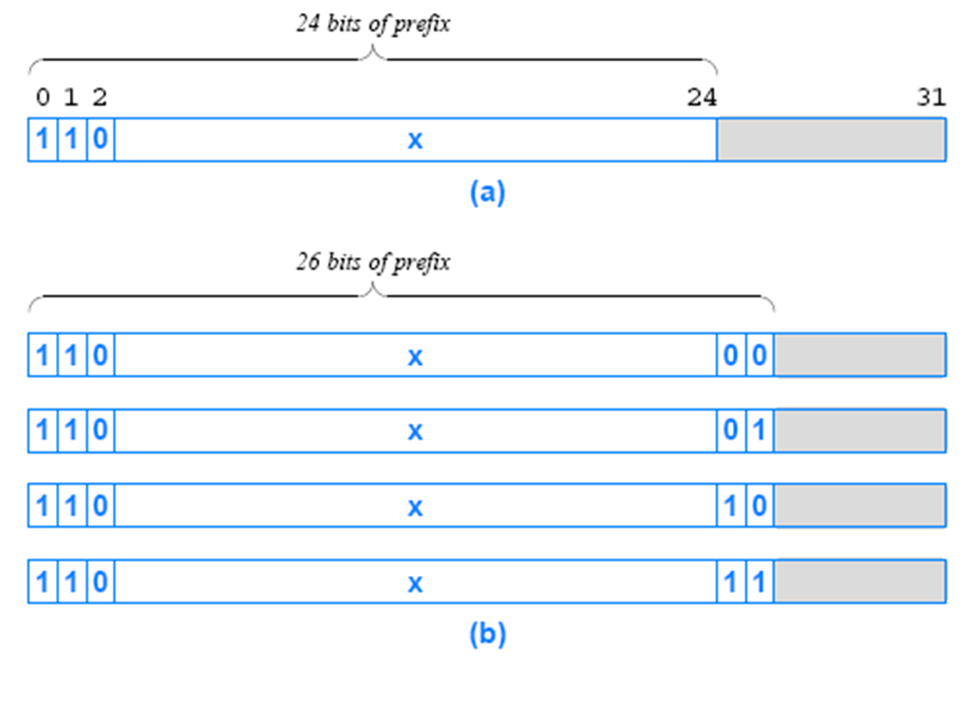
Subnets and Classless Addressing
Classful addressing
1981-1993
A, B, C, D, E
Problems?
CIDR
Classless Inter-Domain Routing
subnet portion of address of arbitrary length
address format: a.b.c.d/x, where x is the number of bits in the subnet portion of address

Slide 33
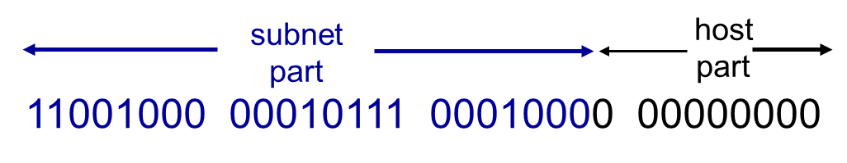
Address Mask
 | Dotted-decimal | Binary
Subnet | 200.23.16.0/23 | 11001000 00010111 00010000 00000000
Mask | 255.255.254.0 | 11111111 11111111 11111110 00000000
Address | 200.23.16.24 | 11001000 00010111 00010000 00011000
Prefix | 200.23.16.0 | 11001000 00010111 00010000 00000000
Notes:
23 is the number of one bits in the mask

Slide 34
Address Mask
 | Dotted-decimal | Binary
Subnet | 200.23.16.0/23 | 11001000 00010111 00010000 00000000
Mask | 255.255.254.0 | 11111111 11111111 11111110 00000000
Address | 200.23.16.24 | 11001000 00010111 00010000 00011000
Prefix | 200.23.16.0 | 11001000 00010111 00010000 00000000
Notes:
23 is the number of one bits in the mask

Slide 35
Address Mask
 | Dotted-decimal | Binary
Subnet | 200.23.16.0/23 | 11001000 00010111 00010000 00000000
Mask | 255.255.254.0 | 11111111 11111111 11111110 00000000
Address | 200.23.17.24 | 11001000 00010111 00010001 00011000
Prefix | 200.23.16.0 | 11001000 00010111 00010000 00000000
Notes:
23 is the number of one bits in the mask

Slide 36
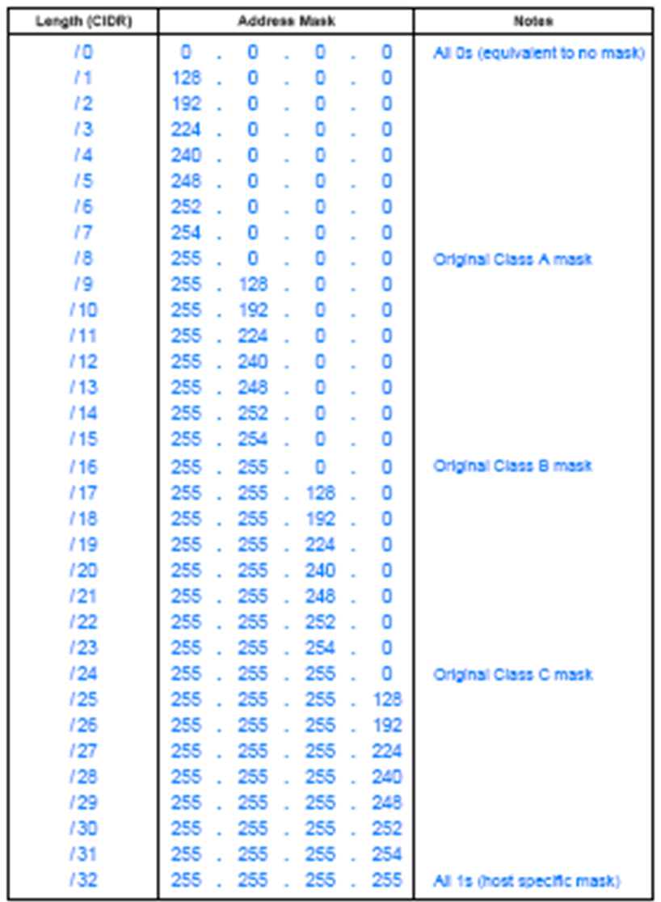
CIDR Notation in Dotted-Decimal

Slide 37
A CIDR Example
Assume an ISP has the following block
128.211.0.0/16
10000000 11010011 00000000 00000000
Suppose the ISP has 2 customers
one customer needs 12 IP addresses
the other needs 9
The binary value assigned to customer1 is:
10000000 11010011 00000000 0000 0000
The binary value assigned to customer2 is:
10000000 11010011 00000000 0001 0000
The ISP can assign
customer1 CIDR: 128.211.0.0/28
customer2 CIDR: 128.211.0.16/28
both customers have the same mask size (28 bits), the prefixes differ
There is no ambiguity
Each customer has a unique prefix
ISP retains most of the original address block it can then allocate to other customers
What are the host addresses for each customer?
Notes:
Save two addresses for the network ID and broadcast

Slide 38
Subnetting
Adds networks, but decreases number of hosts
Suppose you are an ISP with a /24 address block. Can accommodate a request from a customer who needs addresses for 255 computers?
/24 yields 256 addresses, but 254 hosts
Such request cannot be fulfilled

Slide 39
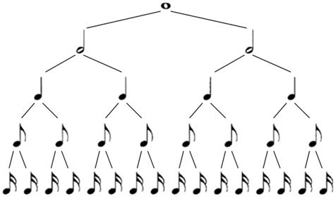
Subnetting is Music

Slide 40
Subnetting
Suppose you are ISP that owns a /22 address block. Show the CIDR allocation you would use to allocate address blocks to four (4) customers who need addresses for sixty (60) computers each.
Considering the initial block is 192.168.0.0/22, what are the subnet IDs?
What are the possible host addresses?
Subnet ID | Mask | First host | Broadcast
192.168.0.0 | 26 | 192.168.0.1 | 192.168.0.63
192.168.0.64 | 26 | 192.168.0.65 | 192.168.0.127
192.168.0.128 | 26 | 192.168.0.129 | 192.168.0.191
192.168.0.192 | 26 | 192.168.0.193 | 192.168.0.255

Slide 41
VLSM
Suppose you are an ISP with a /22 address block. Can accommodate requests from six (6) customers who need addresses for 9, 15, 20, 41, 128, and 260 computers, respectively? If yes, how? If not, explain.
If an ISP owns /22 address block, then number of addresses available will be $2^{32−22}=2^{10}=1024$
We should look at the distribution of these available addresses in a very efficient way. For example, if we want to assign a block for 260 addresses, $2^{8}=256$ is less and $2^{9}=512$ is a lot (lots of addresses are wasted).

Slide 42
VLSM
Notes:
http://www.computernetworkingnotes.com/ccna-study-guide/vlsm-tutorial-with-examples.html

Slide 43
VLSM (4.3.0.0/22)
Subnet | Needed Size | Allocated Size | Address | Mask | Dec Mask | Assignable Range | Broadcast
F | 260 | 510
E | 128 | 254
D | 41 | 62
C | 20 | 30
B | 15 | 30
A | 9 | 14

Slide 44
VLSM (4.3.0.0/22)
Subnet | Needed Size | Allocated Size | Address | Mask | Dec Mask | Assignable Range | Broadcast
F | 260 | 510 | 4.3.0.0 | /23 | 255.255.254.0 | 4.3.0.1 - 4.3.1.254 | 4.3.1.255
E | 128 | 254 | 4.3.2.0 | /24 | 255.255.255.0 | 4.3.2.1 - 4.3.2.254 | 4.3.2.255
D | 41 | 62 | 4.3.3.0 | /26 | 255.255.255.192 | 4.3.3.1 - 4.3.3.62 | 4.3.3.63
C | 20 | 30 | 4.3.3.64 | /27 | 255.255.255.224 | 4.3.3.65 - 4.3.3.94 | 4.3.3.95
B | 15 | 30 | 4.3.3.96 | /27 | 255.255.255.224 | 4.3.3.97 - 4.3.3.126 | 4.3.3.127
A | 9 | 14 | 4.3.3.128 | /28 | 255.255.255.240 | 4.3.3.129 - 4.3.3.142 | 4.3.3.143

Slide 45
Route Aggregation
Where will a packet with destination IP 200.23.19.1 go?
Organization 0
200.23.16.0/23
Organization 1
200.23.18.0/23
Advertise
200.23.16.0/20
Organization 2
200.23.20.0/23
.
Norse Troll ISP
.
.
.
.
Internet
Organization 7
.
200.23.30.0/23
Norse Dwarf ISP
Advertise
199.31.0.0/16
Notes:
Organizations

Slide 46
Route Aggregation
Where will a packet with destination IP 200.23.19.1 go?
Organization 0
200.23.16.0/23
Advertise
200.23.16.0/20
Organization 2
200.23.20.0/23
.
Norse Troll ISP
.
.
.
.
Internet
Organization 7
.
200.23.30.0/23
Norse Dwarf Troll ISP
Advertise
199.31.0.0/16
200.23.18.0/23
Organization 1
200.23.18.0/23

Slide 47
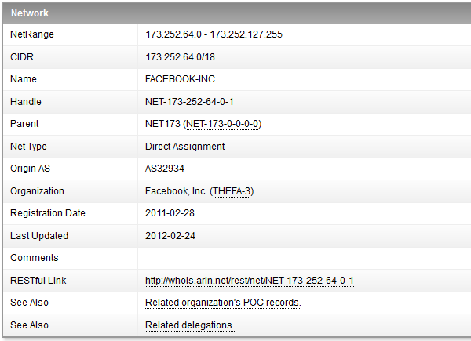
Subnets and Firewalls

Slide 48
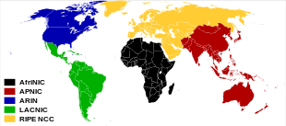
Internet Addressing
Internet Corporation for Assigned Names and Numbers
icann.org
Allocates addresses
Manages DNS
Assigns domain names, resolves disputes
Regional Internet Registry
ARIN
RIPE LACNIC
APNIC
AFRINIC

Slide 49
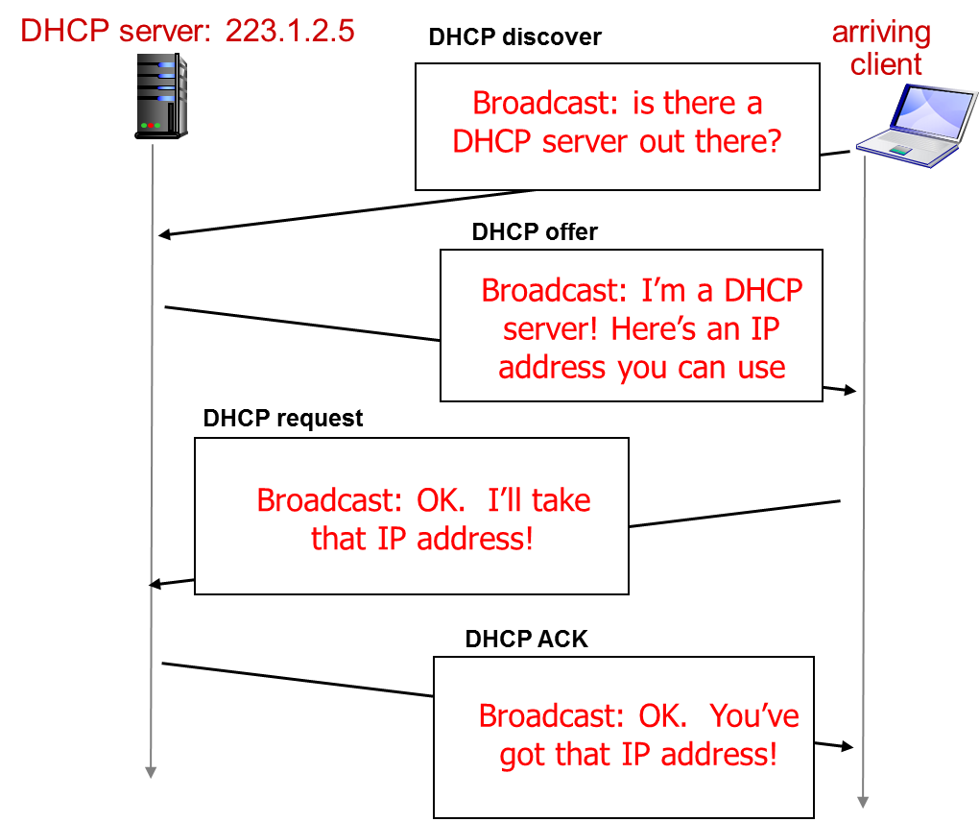
Dynamic Host Configuration Protocol
What’s the purpose?
Dynamic Host Configuration
What information is supplied?
Host address
Subnet mask
Gateway address
DNS server
Lease time

Slide 50
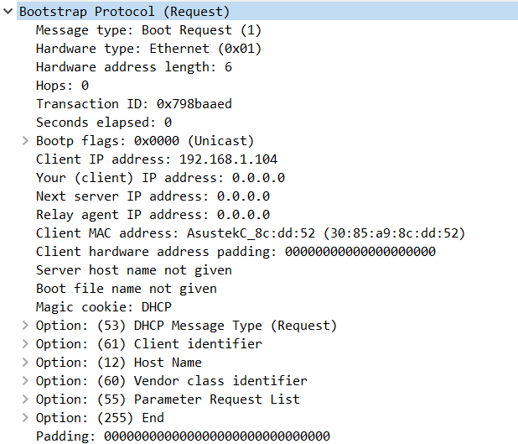
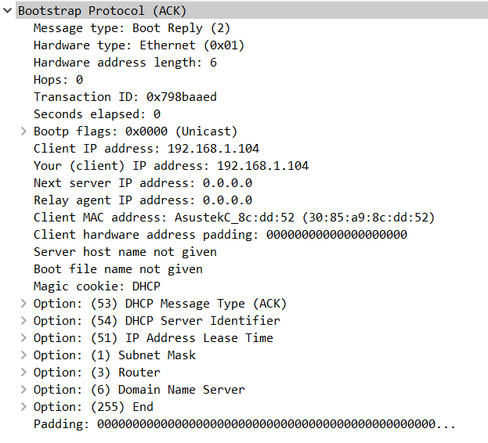
Dynamic Host Configuration Protocol

Slide 51
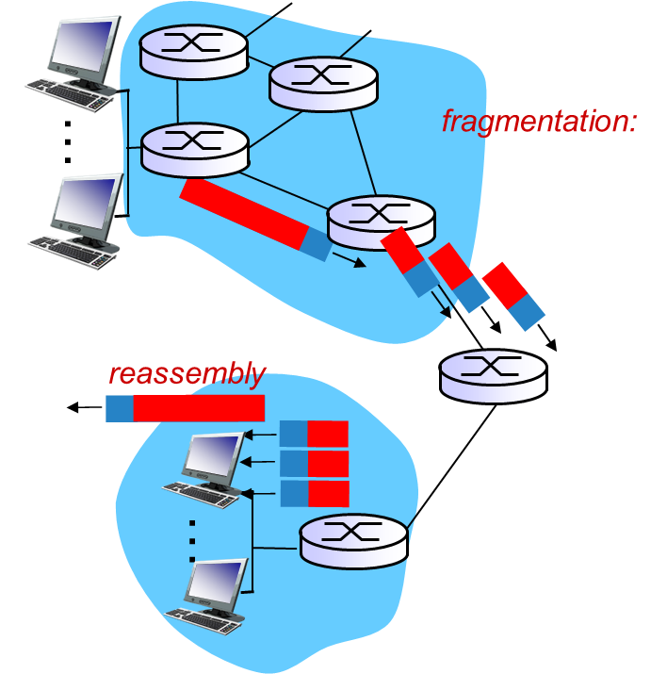
Fragmentation
Network links have MTU (max transit unit)
different link types, different MTUs
Ethernet – 1500
802.11 - 7981
Large IP packets divided
one packet becomes several
“reassembled” only at final destination

Slide 52
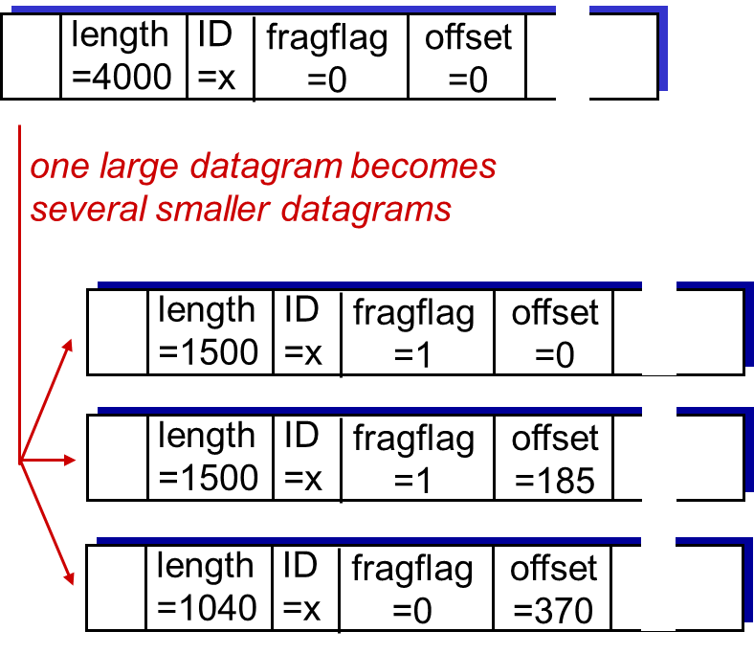
Fragmentation
Flag
1 means “more coming”
10 means “don’t fragment”
Offset
Specified in 8-byte chunks
Identification
The same as original
Reassembly
End system
Dangers
Busy routers
Bogus fragments

Slide 53
Internet Control Message Protocol

Slide 54
Overview
Used by hosts & routers to communicate network-level information
error reporting
unreachable host, network, port, protocol
echo request/reply (used by ping)
Network-layer above IP
ICMP messages carried in IP datagrams
ICMP message
Type
Code
First 8 bytes of IP datagram causing error
Type | Code | Description
0 | 0 | echo reply (ping)
3 | 0 | dest network unreachable
3 | 1 | dest host unreachable
3 | 2 | dest protocol unreachable
3 | 3 | dest port unreachable
3 | 6 | dest network unknown
3 | 7 | dest host unknown
8 | 0 | echo request (ping)
9 | 0 | route advertisement
10 | 0 | router discovery
11 | 0 | TTL expired
12 | 0 | bad IP header

Slide 55
NAT
Network Address Translation

Slide 56
Network Address Translation
Class | Networks | Hosts per network | Starting address | Ending address | Private | Special case
 |  |  | 0.0.0.0
A | 126 | 16,777,214 | 1.0.0.0 | 126.255.255.255 | 10.0.0.0-10.255.255.255
LL |  |  | 127.0.0.0 | 127.255.255.255
B | 16,384 | 65,534 | 128.0.0.0 | 191.255.255.255 | 172.16.0.0-172.31.255.255 | 169.254.0.1-169.254.255.254
C | 2,097,152 | 254 | 192.0.0.0 | 223.255.255.255 | 192.168.0.0-192.168.255.255
D |  |  | 224.0.0.0 | 239.255.255.255
E |  |  | 240.0.0.0 | 255.255.255.254
LB |  |  |  | 255.255.255.255

Slide 57
Network Address and Port Translation
local network
(e.g., home network)
10.0.0/24
rest of
Internet
10.0.0.1
10.0.0.4
10.0.0.2
138.76.29.7
10.0.0.3

Slide 58
Network Address Translation
Advantages
Disadvantages
Range of addresses not needed from ISP
just one IP address for all devices
Can change addresses of devices in local network without notifying outside world
Can change ISP without changing addresses of devices in local network
Devices inside local net not explicitly addressable, visible by outside world
a security plus
Violates end-to-end principle
Ports used to identify hosts
Patch rather than a solution

Slide 59
NAT
NAT translation table
WAN side addr LAN side addr
2: NAPT router
changes datagram
source addr from
10.0.0.1, 3345 to
138.76.29.7, 5001,
updates table
1: host 10.0.0.1
sends datagram to
128.119.40.186, 80
138.76.29.7, 5001 10.0.0.1, 3345
…… ……
S: 10.0.0.1, 3345
D: 128.119.40.186, 80
10.0.0.1
1
2
S: 138.76.29.7, 5001
D: 128.119.40.186, 80
10.0.0.4
10.0.0.2
138.76.29.7
S: 128.119.40.186, 80
D: 10.0.0.1, 3345
4
S: 128.119.40.186, 80
D: 138.76.29.7, 5001
3
10.0.0.3
4: NAPT router
changes datagram
dest addr from
138.76.29.7, 5001 to 10.0.0.1, 3345
3: reply arrives
dest. address:
138.76.29.7, 5001

Slide 60
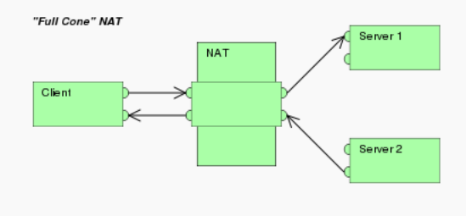
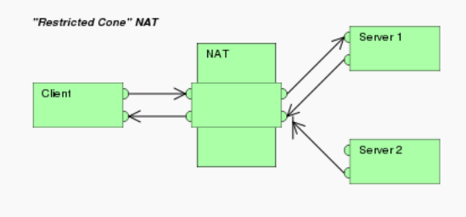
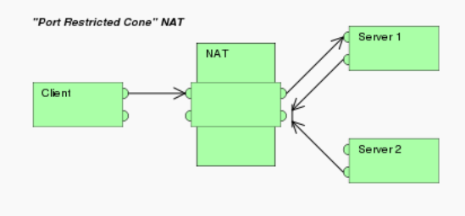
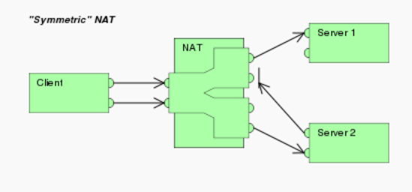
Network Address Translation
One-to-one NAT
(Address)-restricted-cone NAT
(Port)-restricted-cone NAT
Symmetric NAT

Slide 61
Internet Protocol, version 6

Slide 62
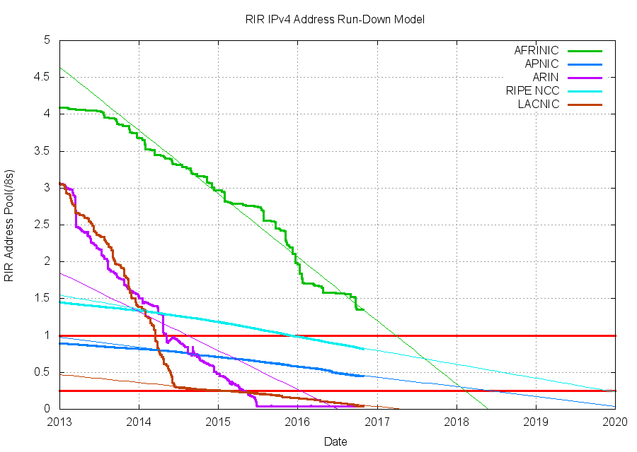
IPv6

Slide 63
IPv6 Header Format
ver
pri
flow label
payload len
next hdr
hop limit
source address
(128 bits)
destination address
(128 bits)
data
32 bits

Slide 64
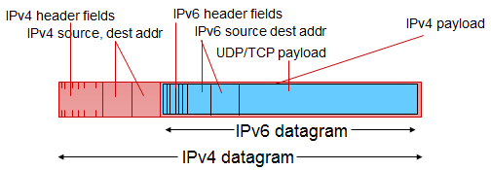
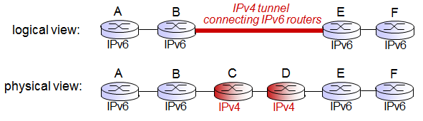
IPv4 to IPv6 Transition
Dual stack
Tunneling
6to4
IPv6 inside IPv4
Teredo
IPv6 inside UDP

Slide 65
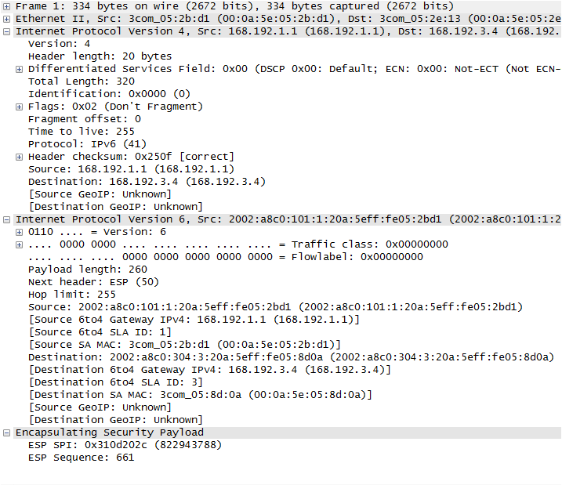
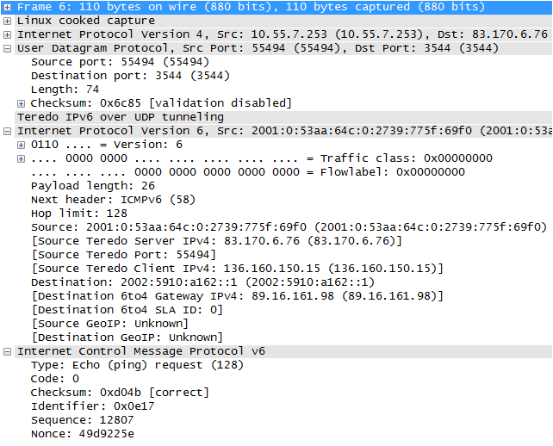
IPv4 to IPv6 Transition
6to4
Teredo

Slide 66
Thank You!

